Slide 1

General integrated science
Task 8- fermentation reactions in food
By: Michael Shamuyarira

Slide 2
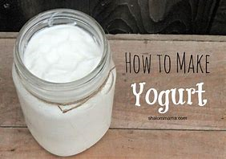
Phase 1
Fresh milk and cream is fermented using lactic bacteria starters or “cultural” lactobacillus bulgaricus and streptococcus thermophiles.
The bacteria are added to heated, pasteurized, homogenized milk, and the milk is then incubated at a specific temperature to maximize the activity of the bacteria.

Slide 3
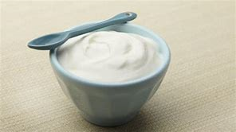
Phase 2
The bacteria converts the lactose to lactic acid which thickens the milk and gives it the tangy taste characteristic of yogurt.
The yogurt is then cooled and can be flavoured with fruit, sugar, other sweeteners or flavourings. Stabalizers, such as gelatin, may also be added.

